Slide 1
Growth in Advertising Expenditures
Analysis of Emerging Technologies
By Diana Bernal

Slide 2
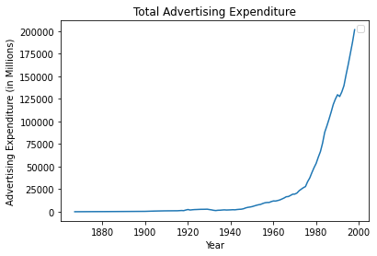
This line is graphed by advertising expenditures from all mediums including magazines, direct mail, television, and the internet. Advertising expenditures slowly increased between 1867 to 1970. Between 1970 to 1980, it began to exponentiate. After the 1980’s, it began to increase rapidly. There was slight downward slope in 1990, most likely from the early 1990’s recession. However, the most important thing to note is that advertising expenditures have kept going up with very minimal decrements. A lot of resources and money went into advertisements. In 1998, the total advertising expenditure was around 200 billion. Business booms when there is an increase in consumption. Advertisements sell a concept that appeals to consumers and their emotions with the goal for products and services to be purchased.

Slide 3
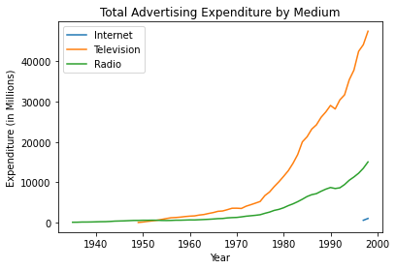
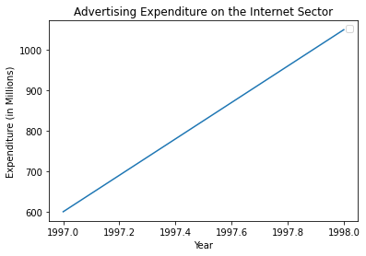
In this graph, there are three lines representing the expenditures in internet, television, and radio throughout time. The earliest of these technologies was the radio with a slight exponential growth. And the next emerging technology was the television with a more prominent exponential growth than the one before. Finally, the most recent technology has been the internet. Although no exponential growth can be seen, advertising expenditures on the internet almost doubled in the span of one year from 600 million in 1997 to 1050 million in 1998.
Through the emergence of technologies, companies were able to use technology to expand knowledge of their products and services by providing advertisements. Advertisements allow a wider range of consumers to view what products and services are available.

Slide 4
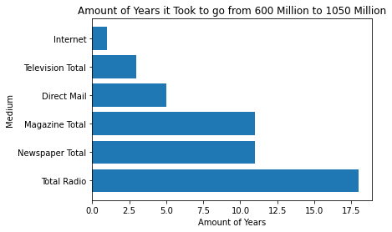
There was limited information for the internet sector. The dataset had only two values for the internet sector: 600 million for the year 1997 and 1050 million for the following year. So I was curious as to how long it took for certain sectors to go from 600 to 1050 million.
Advertising expenditures in the radio sector grew really slowly, taking 18 years for expenditures to go from 600 to 1050 million dollars. Magazine and newspaper sectors both took 11 years with its key technology being the printing press. Direct mail took 5 years. The vast network of roads and transportation made by the postal service make direct mail advertising possible. It took the television 3 years. But the internet sector almost doubled within one year. As new technologies such as the television and the internet became available, companies invested money in producing and marketing their products and services.

Slide 5
Work Cited:
Raff, Daniel M. G. , “Advertising expenditures, by medium: 1867–1998.” Table De482-515 in Historical Statistics of the United States, Earliest Times to the Present: Millennial Edition, edited by Susan B. Carter, Scott Sigmund Gartner, Michael R. Haines, Alan L. Olmstead, Richard Sutch, and Gavin Wright. New York: Cambridge University Press, 2006.
Link to the Data Set used: Advertising Expenditures by Medium (1867 - 1998)

